Slide 1

bp.com/statisticalreview #BPstats
© BP p.I.c.2019

Slide 2
Natural gas

Slide 3
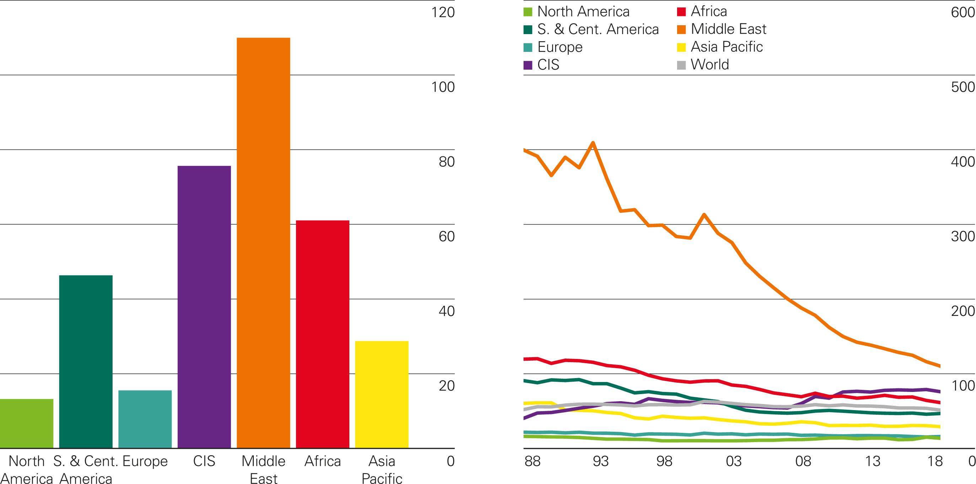
Gas reserves-to-production (R/P) ratios
Years
2018 by region
History

Slide 4
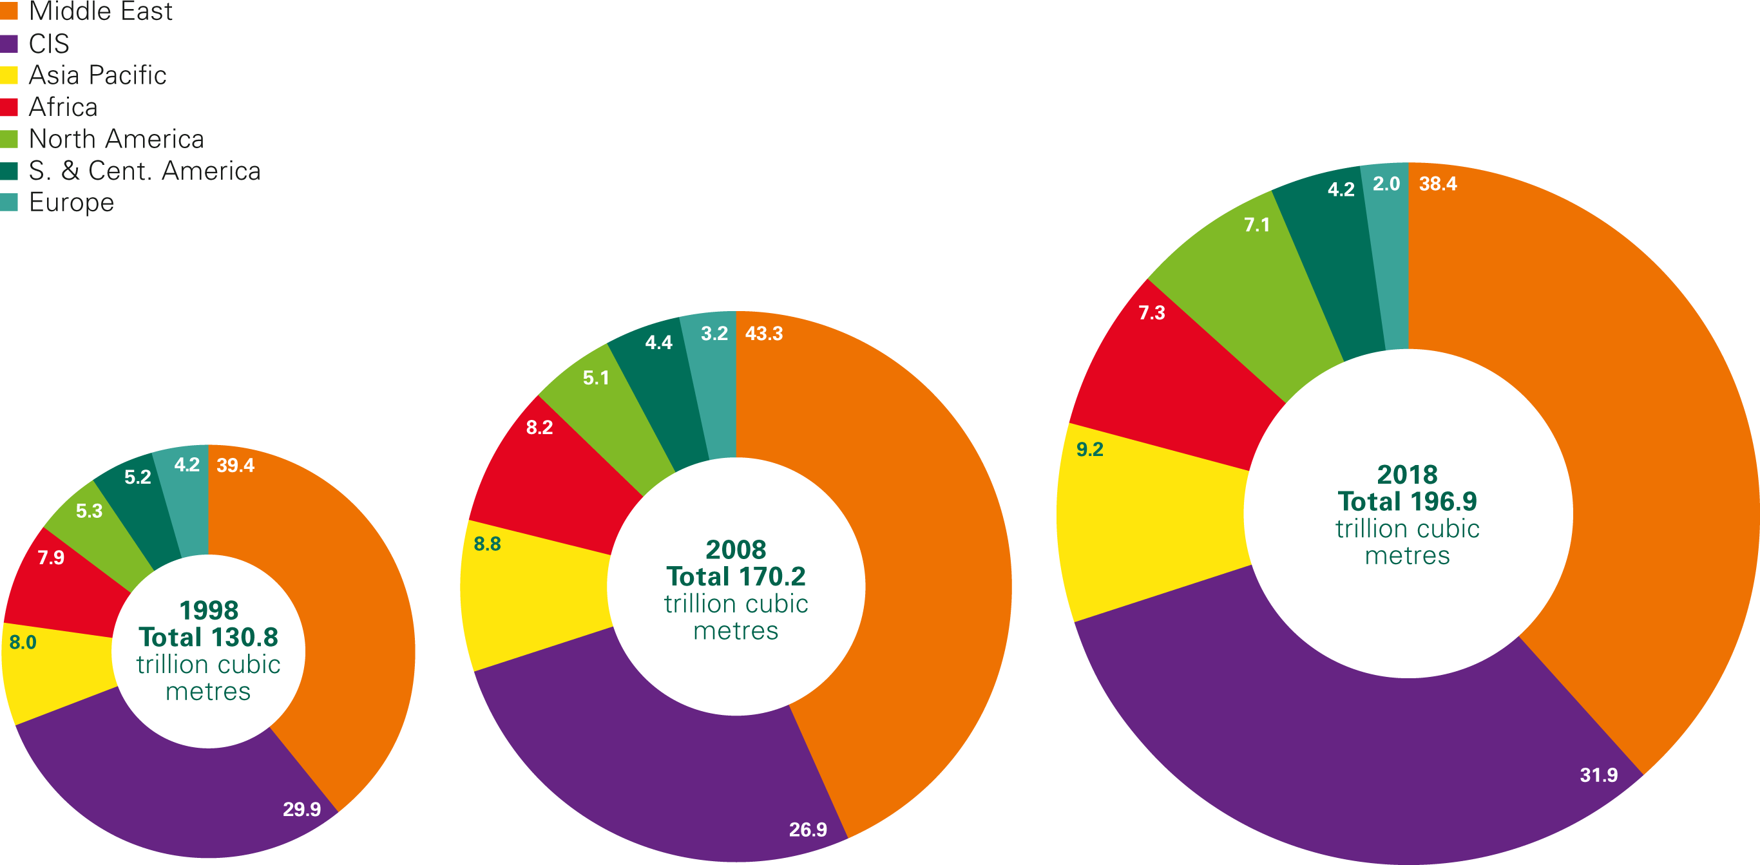
Distribution of proved gas reserves: 1998, 2008 and 2018
Percentage

Slide 5
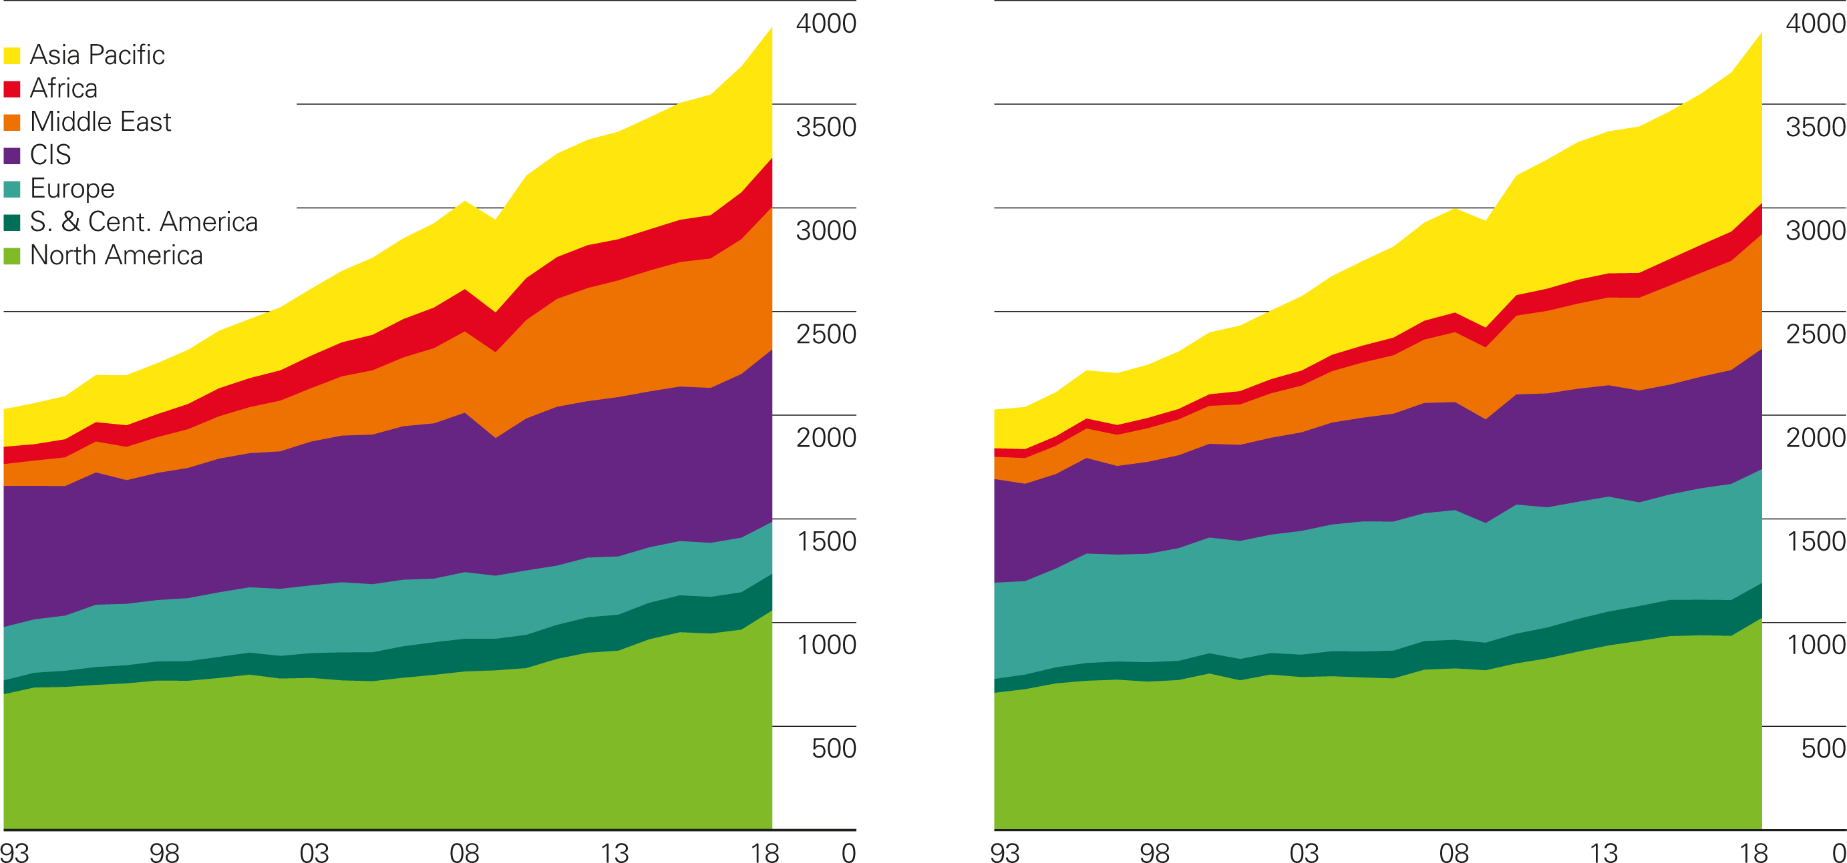
Gas production/consumption by region
Billion cubic metres
Production by region
Consumption by region

Slide 6
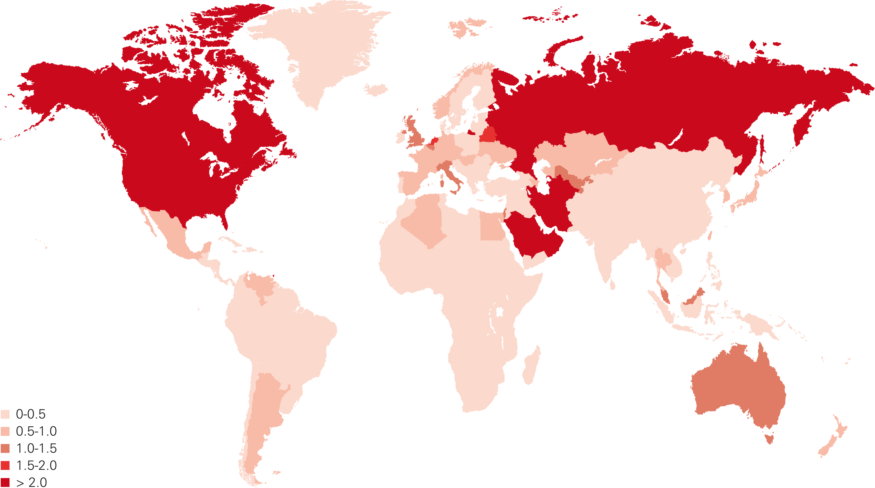
Gas consumption per capita 2018
Million tonnes oil equivalent

Slide 7
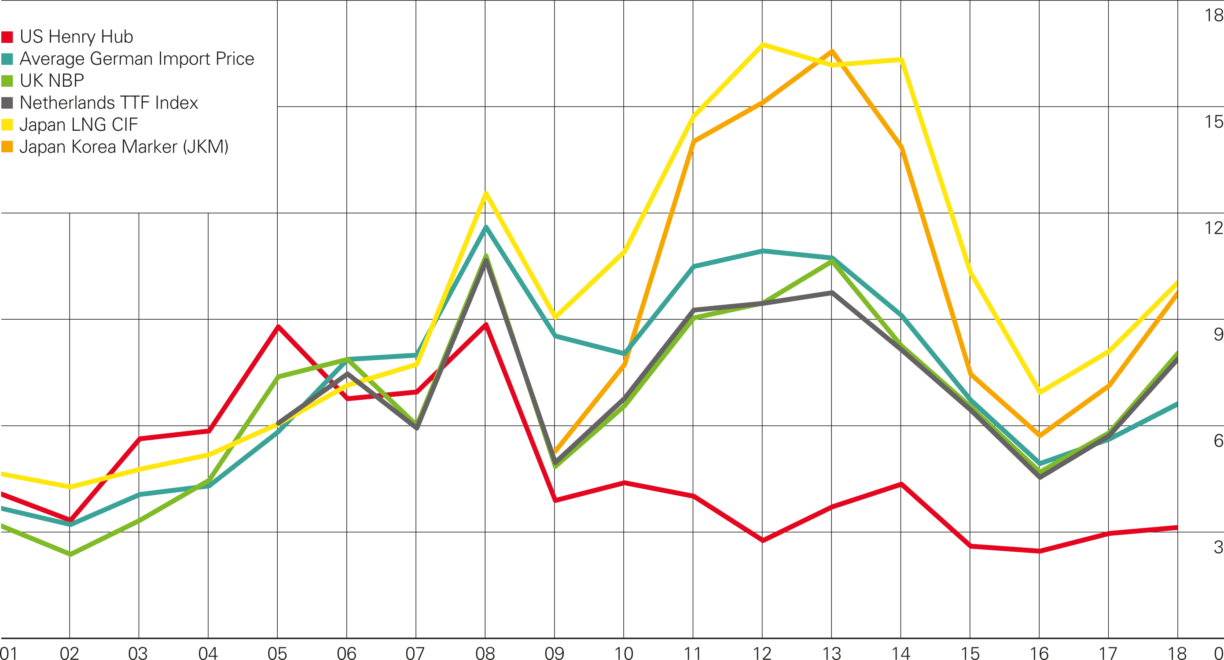
Gas prices
$/mmBtu

Slide 8
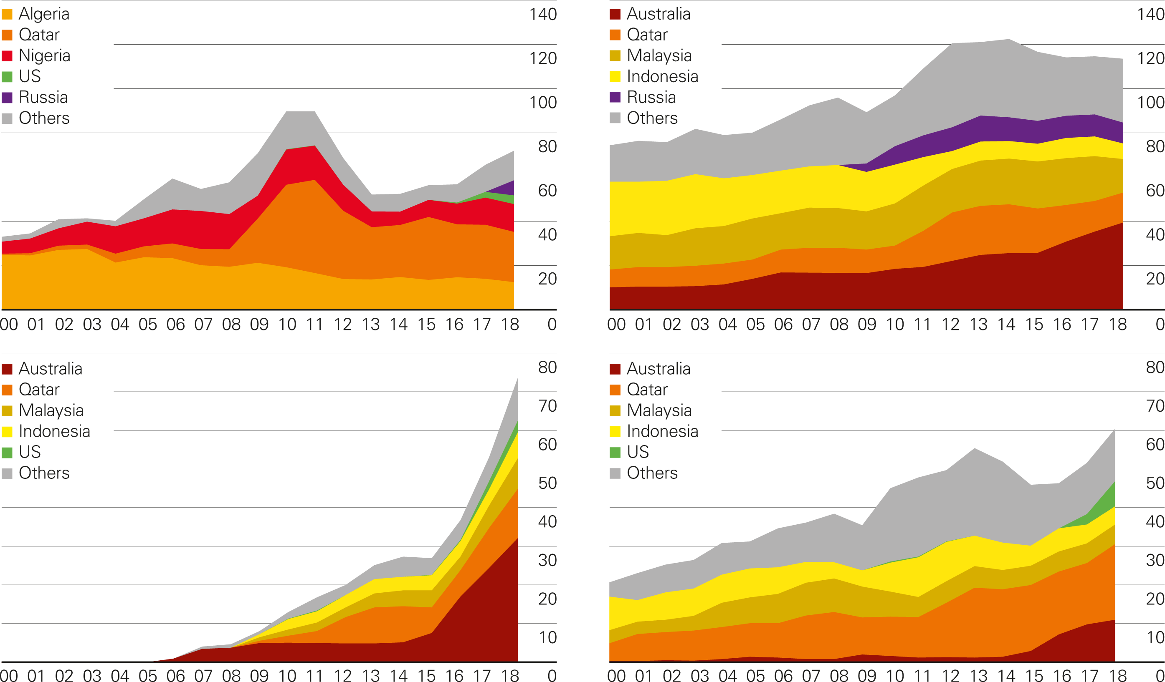
LNG imports by source
Billion cubic metres
Europe
Japan
China
South Korea

Slide 9
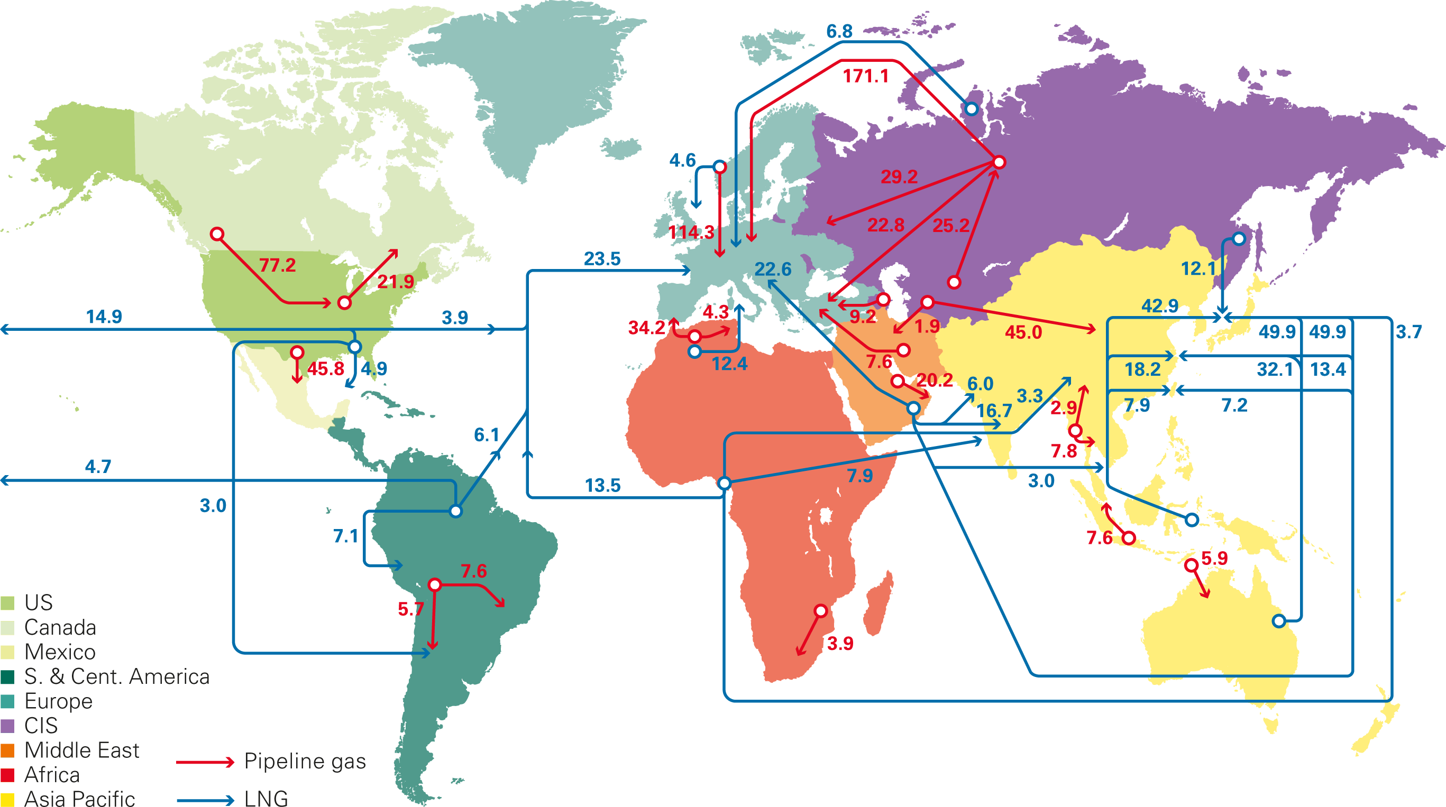
Major gas trade movements 2018
Trade flows worldwide (billion cubic metres)
Source: Includes data from FGE MENAgas service, IHS.

